Slide 1

LITTLE SUPER DEVIL
Radu Stama
Raul Brumar
October 2017

Slide 2

The
Concept
Everyone goes to heaven, no matter what they do in life.
You’re the only one that has ever escaped.
Humanity needs your help because there’s no more room
in Heaven and ‘they’ want to take over the earth.
You’re a Little Super Devil that has been summoned by a
Sorcerer called Bob.
"Well... This is awkward. Hi Bob, what’s the deal?"

Slide 3

3D
VS
2D
Freedom
Camera placement
Less depth
LOL, JK
Graphics
More complicated
Linear
Pretty complicated
More suitable
Often underrated

Slide 4
‘Every good idea borders on the stupid.’
Michel Gondry
Notes:
Michel Gondry: Eternal sunshine of the Spotless Mind, The Science of Sleep, etc.

Slide 5


Features
Different
environments
Hack and
Slash elements
Platformer
mechanics
Different Enemies
Pop culture
Superpowers
Gate 2.5
Gate 2
Gate 2
Gate 3
Gate 3
Gate 3
We plan on having some solid platformer game mechanics.
Explore with our memorable main character different, colorful, low poly environments.
Outsmart a small variety of enemies which all want to take you out.
Fight your way through the enemies using a simple sword and a small variety of attacks.
Enjoy a variety of pop culture references, as well as a lot of jokes during the playthrough.
Use different spells like shooting fireballs, slowing down the time or even stopping it for a few seconds.

Slide 6






Even more
Puzzles
Collectibles
Checkpoints
Soundtrack
Controls
Break the wall
A few of the levels will also include small puzzle sections.
Collect coins in order to increase the overall score.
Discover different checkpoints that will save your progress as you proceed into the levels.
Sit back and enjoy our original soundtrack.
Simplified controls will make the game more accessible.
Wish we could spoil you more about this, but even mentioning it should get you excited.

Slide 7
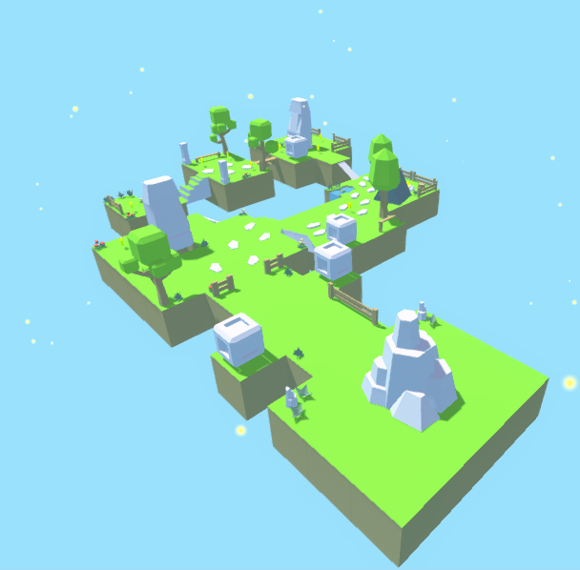
Unique selling points
1
Twisted
The twisted story between Heaven and Hell.
Sneak Peek
2
The looks
The overall low poly look of the game.
3
References
The multitude of pop culture references.
4
The main character
We plan on making the main character memorable and bring him to life as well as we can.
Free PowerPoint Templates

Slide 8
Target
Platform
And
Competition
PC, with versions for both Windows and Linux.
Consoles might follow at a later date if everything goes well with the PC version. And our crazy coder considers an android version as well.
Competition: collectathon games like Hob and the recently released A Hat in Time.

Slide 9
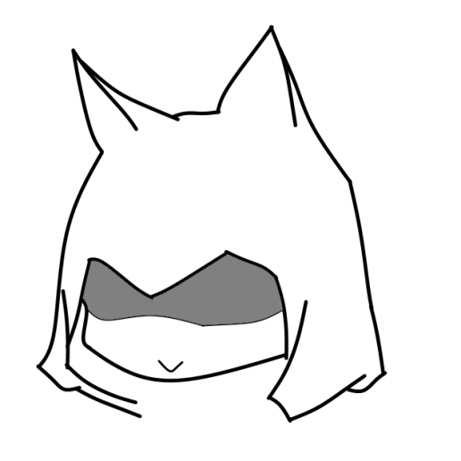
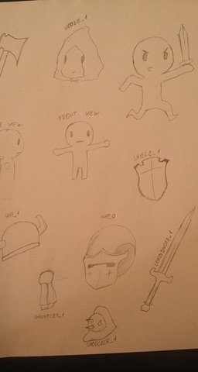
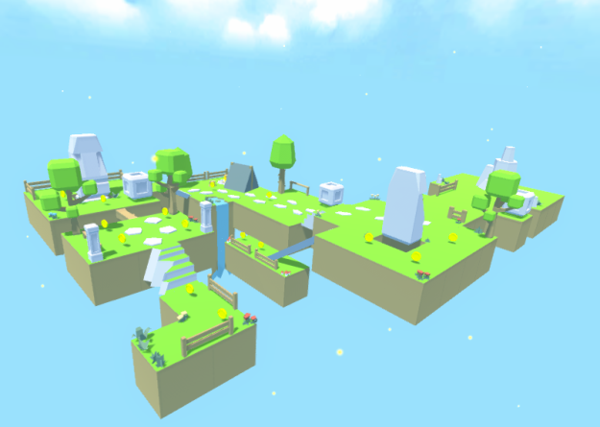
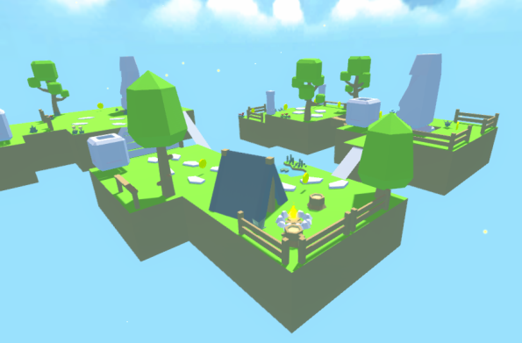
Thank you!
Notes:
Michel Gondry: Eternal sunshine of the Spotless Mind, The Science of Sleep, etc.

